Slide 1


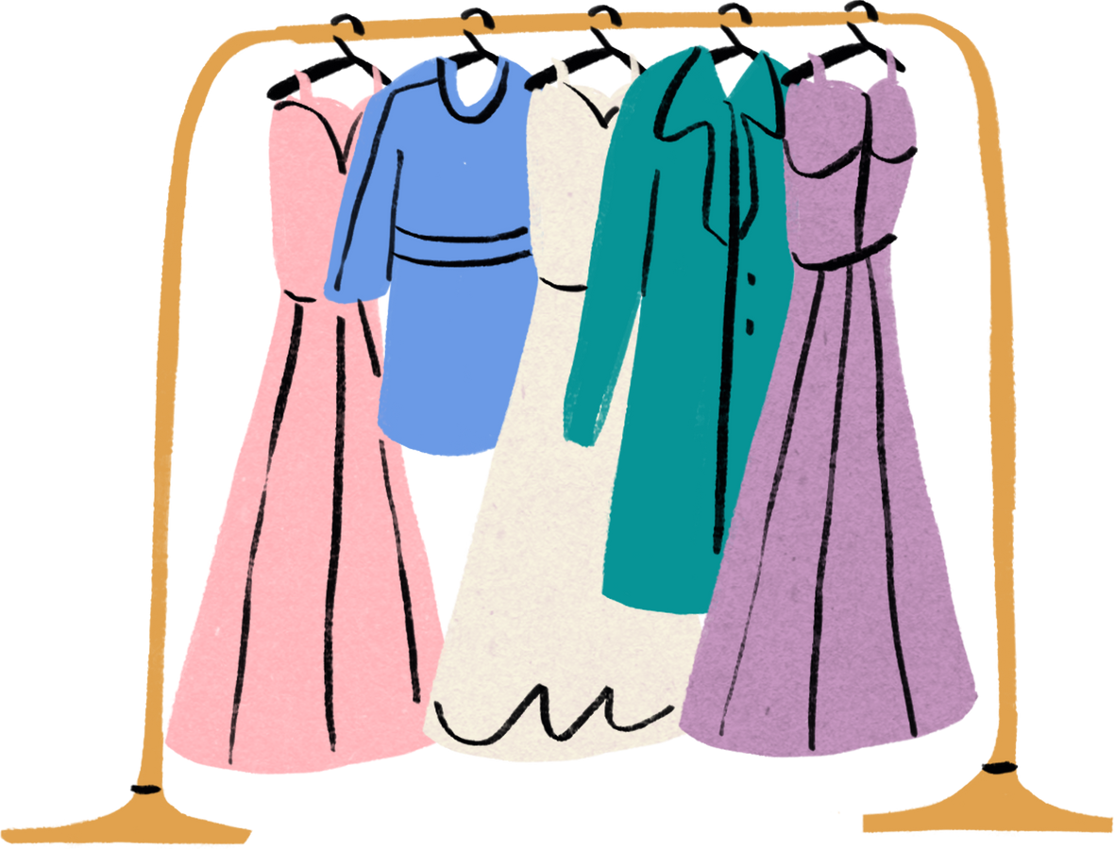
B/YTÉ
Analysis
and Key Findings
For B/YTÉ - A Fashion Retail Brand
Presented By: Elise Samas, Sayuj Sethi, Chujin Xu

Slide 2

Agenda
Company Overview
Problem Overview
Data Analysis
1: Differentiation
2: Supply Chain
3: Digital Trends
Recommendation Summary
Risks and Mitigations
Timeline
Summary
Q & A
References

Slide 3

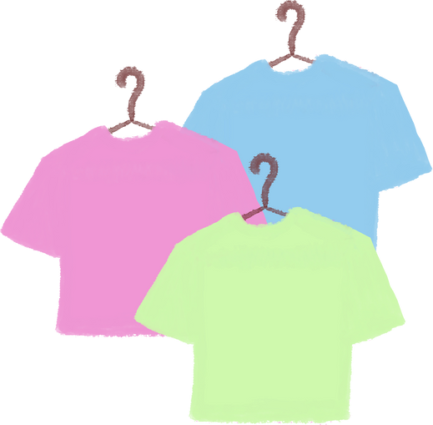
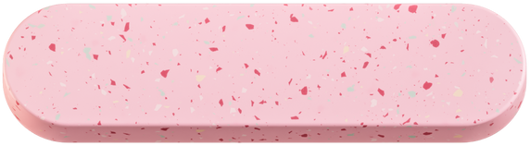
Company Overview
Add Company Name
Customers:
Age - Large age range, most between 21 and 55
Region - Greater Vancouver Area, as store is downtown
Distribution – In person customers only
Online preference
Company:
Founder - Anastasia, A passionate fashion designer, Sauder graduate
Values – Quality, innovation, I &D, accessibility, affordability
Size – Small, one physical store, no online store
Growth – Fast growing, thousands of customers
Competition:
Oucci - High quality, luxury brand
M&H – Affordable clothing for high school and university students
mAritizia – High brand recognition, clothing for young women
Company Overview

Slide 4

S
W
O
T
(Strengths) | (Weaknesses) | (Opportunities) | (Threats)
Unique and authentic high-quality designs Community-driven brand Fast-growing Popularity In-person location | Insufficient marketing efforts Limited online presence Inventory management Inexperienced with website creation | Occupying a different niche in the fashion industry than competitiors Changing consumer buying habits Sustainability trend | Large competitors with established reputations Fashion industry recession Rise in popularity of second-hand clothing
Company Overview

Slide 5
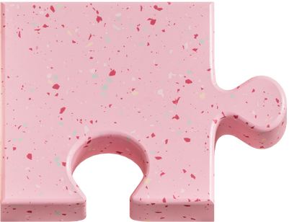
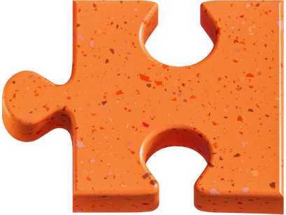

Lack of Differentation
Key selling points and target demographics are unclear
Need to differentiate in order to improve marketing efforts
B/YTÉ
Problem Statement
Ineffective Supply Chain Management
Inability to meet demand during peak months
Excess inventory other months
Lack of Fit with Current Digital Trends
No online store severely limits B/YTÉ’s market share in an increasingly online industry
Problem Statement

Slide 6


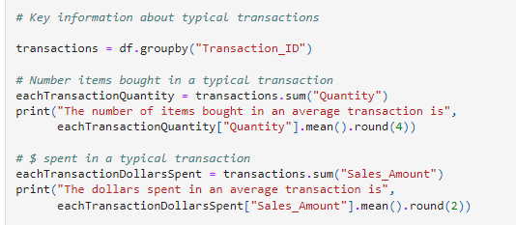
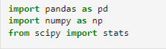

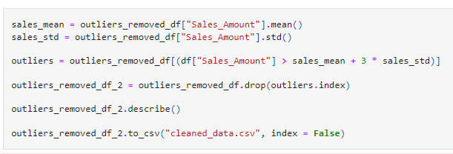
Data Cleaning & Analysis
All analysis was conducted in Python with additional functionality from Plotly and Pandas libraries.
Data Analysis

Slide 7
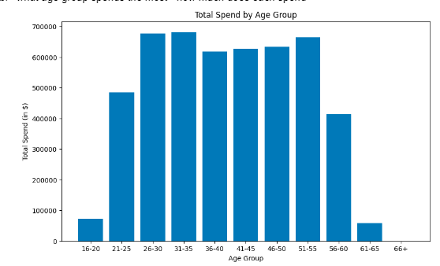
Differentation
Problem 1: Differentiation
A) Target Age
B) POD – Affordability:
Claims to balance quality and affordability
10 most popular items range from $45 to $152
Most expensive items cost upwards of $300
Total spend and # transactions greatest among ages 26-35
-> Target 🎯
1: Differentiation

Slide 8
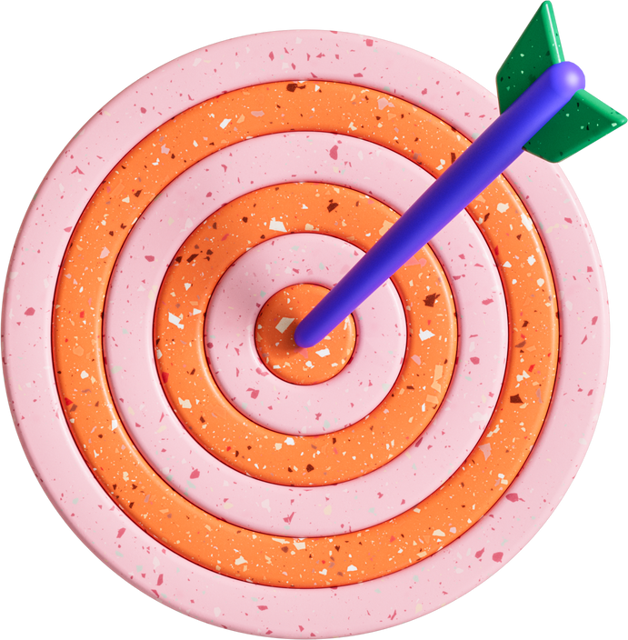
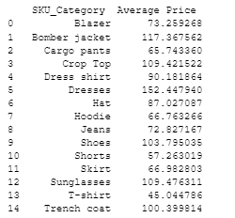

Solution:
Target Age + Focus on Price
.
1) Target Ages 26 -35
Competitors targeting young adults (16 – 22) or those opting for a higher price range -> creates a niche
2) Lower Prices While Maintaining Profitability
1: Differentiation

Slide 9
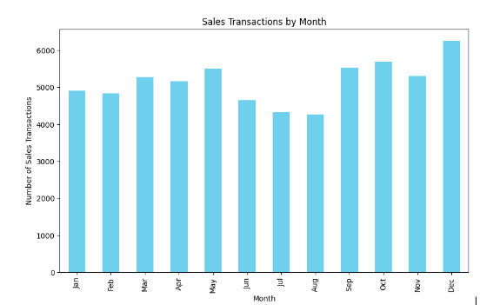
Supply Chain
Problem 2: Supply Chain
Inability to meet demand during peak months
Excess inventory other months
No obvious seasonal or monthly patterns
2: Supply Chain

Slide 10
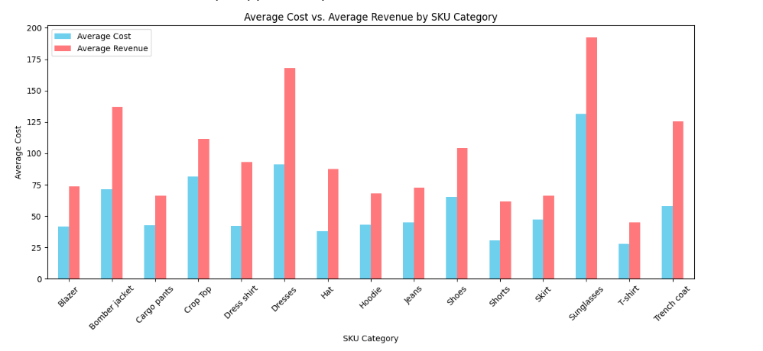
Solution: Swap to Local Suppliers
No Clear Patterns in Time of Purchase…
Can’t predict in advance how much inventory to order!
Need to be able to add inventory on short notice
Local Supplier
Added benefit: Increase sustainability
Added issue: Higher costs
Large profit margin for most categories, don’t need to increase prices
2: Supply Chain

Slide 11
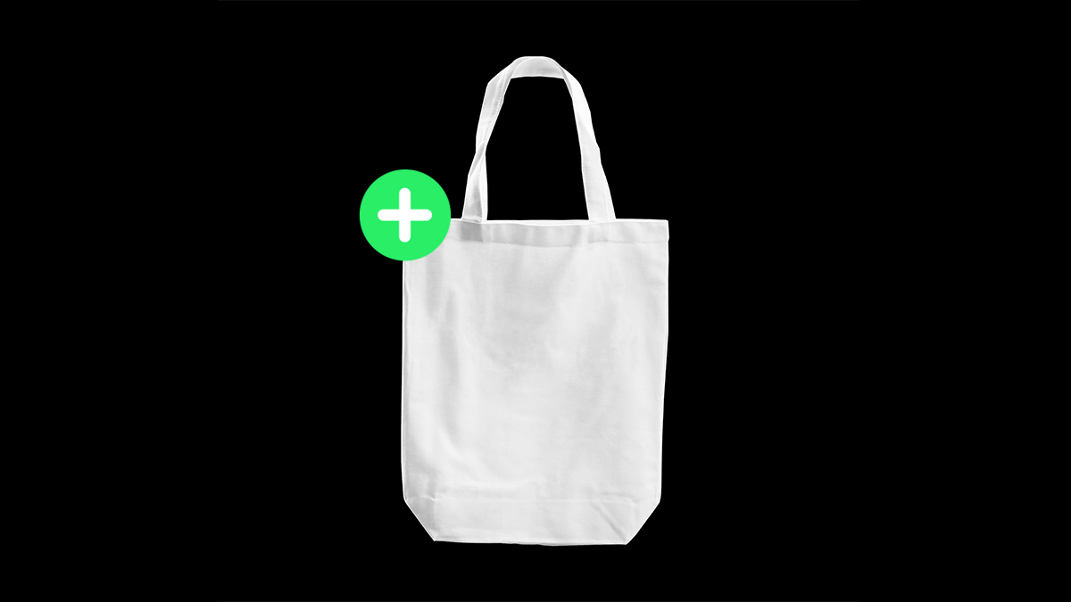
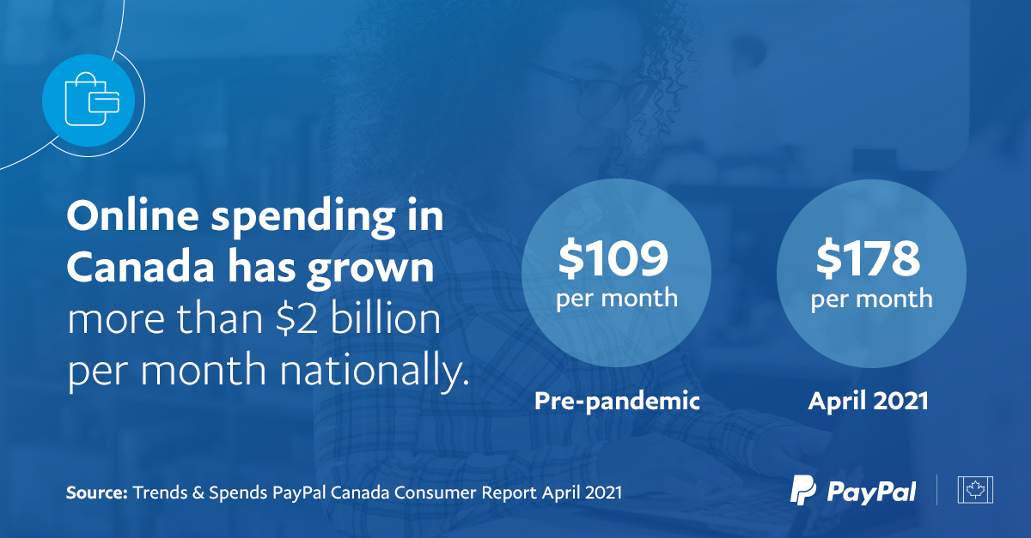
Customers less interested in physical stores due to accessibility and convenience issues. An average month has between 5000 & 6000 transactions.
Digital Trends
Problem 3: Digital Trends
The number of items bought in an average transaction is 2.144.
The average spend in a transaction is $132.64
No online store severely limits B/YTÉ’s market share in an increasingly online industry
Significant increase in online shopping spending compared to pre-pandemic levels.
Over eight in ten Canadians shopped online in 2020.
How would this change if B/YTÉ
had an online store?...
3: Digital Trends

Slide 12
Online stores generate more transactions, but typically lower spend.
HBR study found that BOPIS customers purchase more expensive items than online customers.
Solution:
BOPIS Model
Buy Online, Pick Up In Store
Mitigates delivery and storage costs typically expected of an ecommerce model
Requires online store: additional profit from online purchases will more than cover cost to outsource website (approx. $3000)
Accessibility
Still requires customers to visit physical store…
Curbside pickup for an additional fee
Prevents immuno-compromised individuals from having to go in-store
3: Digital Trends

Slide 13

Back to Agenda
Summary of Recommendations
Target Age and Focus on Price
Addresses: Differentiation
Swap to Local Supplier
Addresses: Supply Chain Management
Buy Online, Pick Up In Store
Addresses: Digital Trends
Summary of Recs

Slide 14

Risk: Decrease in quality due to decreased prices
Mitigation: Stop carrying inventory for expensive products with low margins
Risk: Damaging increase in costs from changing suppliers
Mitigation: Carefully selecting a local supplier who can balance quality and costs
Risk: High costs of online store
Mitigation: BOPIS prevents owners from incurring additional shipping & storage costs
Risks
and Mitigations
Risks and Mitigations

Slide 15
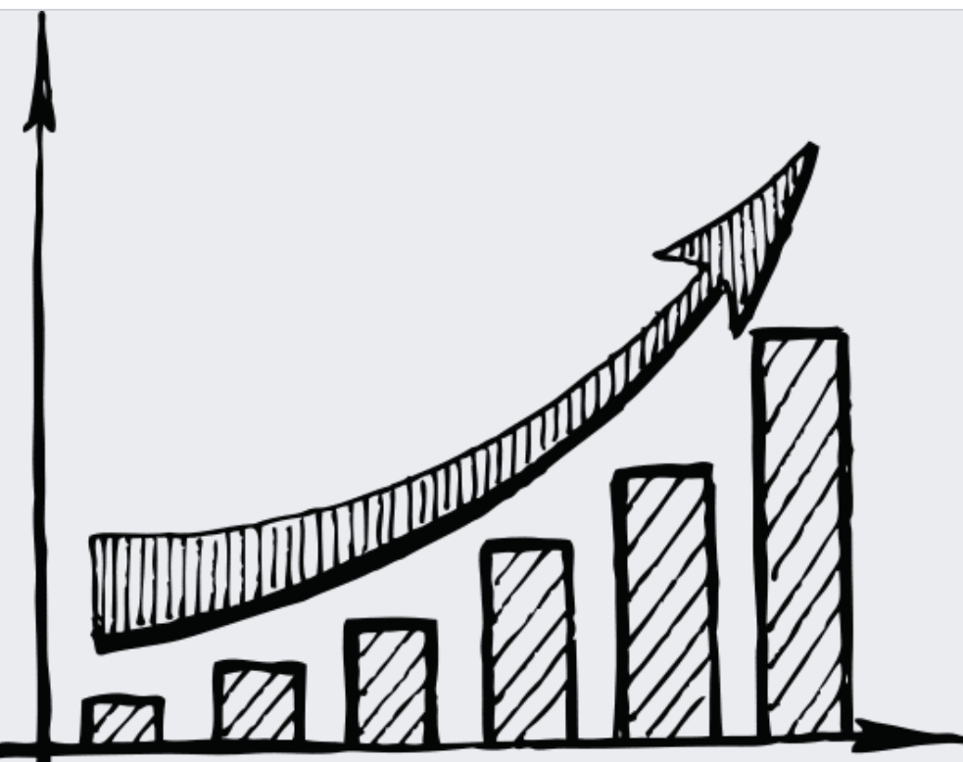
Timeline
9-10 2023
11-12 2023
1-2 2024
3-4 2024
End contract with current supplier & select new supplier
Adjust product and offer a wide range of size options
Adjust prices to account for affordability & new supplier
Start regularly posting on social media
Begin receiving new supply and conduct quality assurance check
Website development
Launch targeted online advertising campaign
Online Store Opens
Continue to enhance social media engagement
Evaluate the impact of all implemented strategies on sales and profits
Timeline

Slide 16
Weaknesses in differentiation, supply chain, and trend alignment are remedied by changing customer focus, suppliers, and store model
Lack of Differentiation:
No specific age group targeted
Ages 26 – 35 have a total spend upwards of $600,000 and highest # transactions
Affordability as a core value
Popular item prices of $45 - $152
1
Target Age and Focus on Price
Targeting adults ages 26-35 creates a different core customer base from our competitors, allowing for more effective marketing. Lowering prices will further differentiate us from our customers – balance quality & affordability as per values.
Ages 26 - 35
New pricing model in line with values
Effective marketing
Supply Chain Weakness :
Inability to predict demand
Number of transactions range from 4,000 to over 6,000 with no clear pattern
Inefficiency of Global Supplier
Delivery and design of clothing takes 2 months
Swapping to a local supplier allows for inventory to be ordered on a short notice and connects to core value of sustainability.
High profit margins by SKU category demonstrate feasibility of price increase
Already in discussion with many local sustainable suppliers
Mitigates environmental impact of shipping from Germany
2
Swap to Local Supplier
3
Buy Online & Pick-up In Store
BOPIS model allows B/YTÉ to meet demand for online store and accessibility needs without incurring significant additional cost.
Connects to core value of accessibility as it allows customers who can’t shop in store to pick up items via curbside delivery
Still incur web development cost, but does not include shipping and storage costs
Shift in Digital Trends:
Willingness to shop in store
8/10 shopped online 2020
Cost of online store
Web development, shipping, and storage costs
Summary

Slide 17

Q & A
Q & A

Slide 18

References
Ketzenberg , M., & Akturk, S. (2021, May 25). How “Buy Online, Pick Up In-Store” Gives Retailers an Edge. Harvard Business Review. https://hbr.org/2021/05/how-buy-online-pick-up-in-store-gives-retailers-an-edge
Rowe, A. (2023, June 19). Outsourcing Web Design - What You Need to Know. Tech.co. https://tech.co/web-design/outsourcing-web-design
Rowe, A. (2023, June 19). Outsourcing Web Design - What You Need to Know. Tech.co. https://tech.co/web-design/outsourcing-web-design
Canada, P. (2021, June 23). Canadians increased online shopping spend by more than $2b per month compared to pre-pandemic. Cision Canada. https://www.newswire.ca/news-releases/canadians-increased-online-shopping-spend-by-more-than-2b-per-month-compared-to-pre-pandemic-886041380.html
References

Slide 19
Thank you!

